Slide 1
Take a moment to complete the statement below.
“At the end of the day, studying literature is about . . .”
Thanks to Andrew Shipe, Pompano Beach High School
Thanks to Andrew Shipe, Pompano Beach High School for the permission to use these materials.

Slide 2
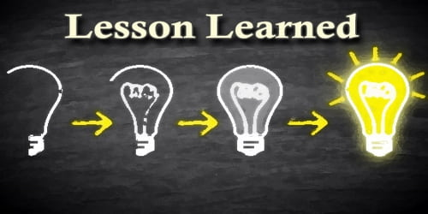
How former students have completed this statement Understanding expression and communication in all of its forms. Learning from the stories and experiences of others Learning to explore art through a different person’s thoughts and expressions Learning the art of communication and imagination Understanding our world through stories and language Immersing yourself in different perspectives and emerging a better person from the experience. Learning that despite our differences, we all have way more in common than we think Seeing an extraordinary world through ordinary words Seeing a culture through its own eyes Learning that the words on the page are unique, but the stories are universal Deepening our understanding of the common human experience, in hopes that a broadened perspective would help us to appreciate the world and contribute to its flourishing Becoming a better person by understanding the perspectives of others Thinking critically and always being curious about the world around you
Thanks to Andrew Snipe, Pompano Beach High School

Slide 3
Where are you and your students on the road to a good score on the AP English Literature exam?
1: A Dirt Road There’s so much dust, I can’t even see the road!! Help!! | 2: A Paved Street It’s fairly smooth , but there are still a lot of potholes that need repair.
3: A State Highway I feel confident but have quite a few traffic jams that slow me down. | 4: An Interstate I’m traveling along at a good pace and could probably give directions to someone else.

Slide 4
In your breakout rooms, discuss: What do you think your students need to do to get to the next level?
Make A T-chart
Objectives | Strategies to help students achieve that objective
Brainstorm. Then prioritize!
What needs to come first, second, etc.? This will probably be different for each of you.
This Photo by Unknown Author is licensed under CC BY-NC-ND

Slide 5
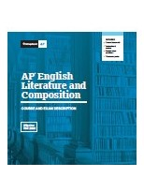
Course Skills and Essential Knowledge

Slide 6
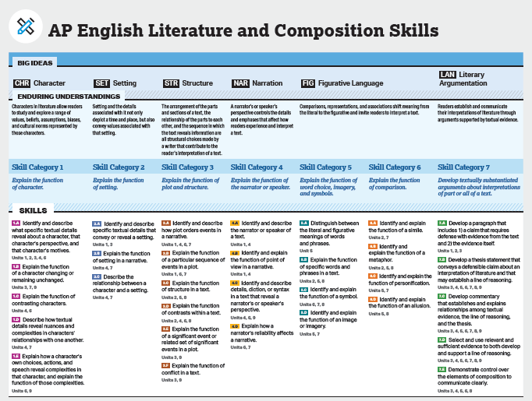
Course Skills
Course skills describe what students should be able to do while studying literary works throughout the course.
Course skills also form the basis of tasks students are asked to perform on the AP Exam.
Students will benefit from multiple opportunities to develop course skills in a scaffolded manner.
CED
p. 19
Notes:
Explain that members of the AP community, including DC members and ETS test developers, identified the set of practices/skills students need to be able to apply on the exam.

Slide 7
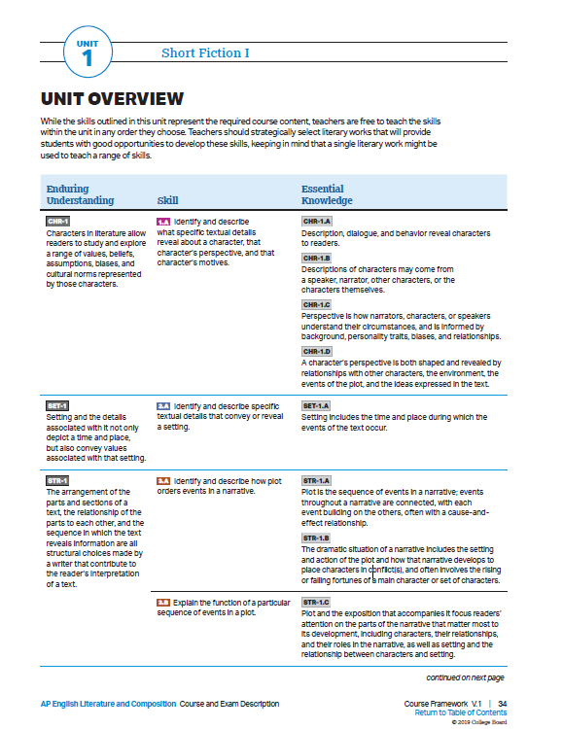
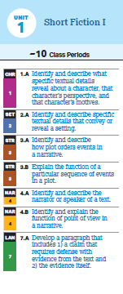
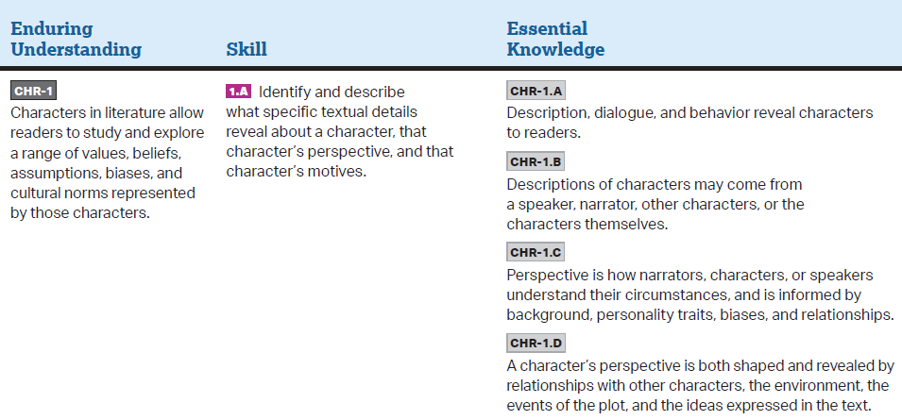
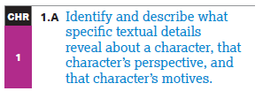
Unit Overview
The Unit Overview shows the course skills, enduring understandings, and associated essential knowledge statements for the unit.
Teachers are free to teach the skills within the unit in any order they choose; that is, they do not have to be taught in the order in which they appear.
The skills define what students should be able to do with the content knowledge.
The skills are the targets of assessment for the AP Exam.
The individual skill is part of a larger skill category that spirals throughout the course.
The questions on the Personal Progress Checks are based on these skills.
CED
p. 34

Slide 8
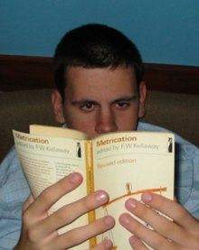
What skills and knowledge are …..?
Foundational: necessary for more complex skills and knowledge to build upon Competent: adequate enough to complete a task independently according to standard, “passing” Expert: intuited strategically to choose tasks depending on situation that allow one to beyond the standards and to create something new
This Photo by Unknown Author is licensed under CC BY-SA

Slide 9
Novice-to-Expert summary
Novice
Has an incomplete understanding, approaches tasks mechanistically and needs supervision to complete them.
Advanced Beginner
Has a working understanding, tends to see actions as a series of steps, can complete simpler tasks without supervision.
Competent
Has a good working and background understanding, sees actions at least partly in context, able to complete work independently to a
standard that is acceptable though it may lack refinement.
Proficient
Has a deep understanding, sees actions holistically, can achieve a high standard routinely.
Expert
Has an authoritative or deep holistic understanding, deals with routine matters intuitively, able to go beyond existing interpretations,
achieves excellence with ease.
Brothers Stuart and Hubert Dreyfus proposed the model in 1980 in an 18-page report on their research at the University of California, Berkeley.

Slide 10
AP English Literature and Composition Scoring Rubrics (Effective Fall 2019)
Scoring Rubric for Question 1: Poetry Analysis (6 points)
Reporting Category | Scoring Criteria
Row A Thesis (0-1 points) | 0 points For any of the following: There is no defensible thesis. The intended thesis only restates the prompt. The intended thesis provides a summary of the issue with no apparent or coherent claim. There is a thesis, but it does not respond to the prompt. |  |  |  | 1 point Responds to the prompt with a thesis that presents a defensible interpretation of the poem.
Row B | 0 points | 1 point | 2 points | 3 points |  | 4 points
Evidence AND Commentary (0-4 points) | Simply restates thesis (if present), repeats provided information, or offers information irrelevant to the prompt. | EVIDENCE: Provides evidence that is mostly general. | EVIDENCE: Provides some specific, relevant evidence. | EVIDENCE: Provides specific evidence to support all claims in a line of reasoning. |  | EVIDENCE: Provides specific evidence to support all claims in a line of reasoning.
 |  | AND | AND | AND |  | AND
 |  | COMMENTARY: Summarizes the evidence but does not explain how the evidence supports the student’s argument. | COMMENTARY: Explains how some of the evidence relates to the student’s argument, but no line of reasoning is established, or the line of reasoning is faulty. | COMMENTARY: Explains how some of the evidence supports a line of reasoning. AND Explains how at least one literary element or technique in the poem contributes to its meaning. |  | COMMENTARY: Consistently explains how the evidence supports a line of reasoning. AND Explains how multiple literary elements or techniques in the poem contribute to its meaning.
Row C Sophistication (0-1 points) | 0 points Does not meet the criteria for one point. | 1 point Demonstrates sophistication of thought and/or develops a complex literary argument. Responses that earn this point may demonstrate a sophistication of thought or develop a complex literary argument by doing any of the following: Identifying and exploring complexities or tensions within the poem. Illuminating the student’s interpretation by situating it within a broader context. Accounting for alternative interpretations of the poem. Employing a style that is consistently vivid and persuasive. This point should be awarded only if the sophistication of thought or complex understanding is part of the student’s argument, not merely a phrase or reference.
September 2019

Slide 11
Sample taxonomy of skill category 7 (not in the language as written in the Course Skills, but stated in your simpler words) (From the scoring rubric) Summarizing a literary text (foundational) Articulating a defensible interpretation of literary text (foundational) Supporting the interpretation with specific references to the text, rather than a summary (foundational) Planning and using a coherent line of reasoning in a response (competent) Explaining the connection(s) between specific reference(s) and a defensible interpretation (competent) Doing all of the above with consistency (expert) Doing all of the above with sophistication (clarity, grace, insight) (expert)

Slide 12
In diverse small groups (representing all four “roads” as much as possible) discuss…
…one of these questions What are the eight most foundational course skills? Focus on a genre (poetry, short fiction, longer works). Look at the three units in your CED and determine which skills are foundational, competent, expert. Would a move a skill from one unit to another? Why? Why not?
Focus on the first three units of the CED and determine which skills are foundational, competent, expert. Would you move a skill from these three units to Units 4-9? Why or why not? Are there skills/knowledge students need to know before they can be successful at the course skills listed in these units?
This Photo by Unknown Author is licensed under CC BY-SA-NC

Slide 13
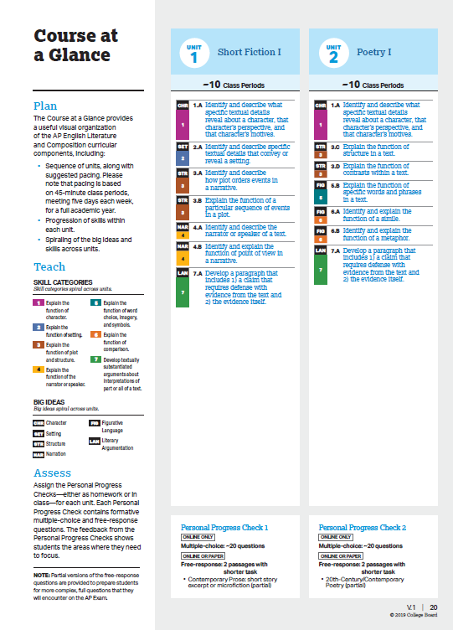
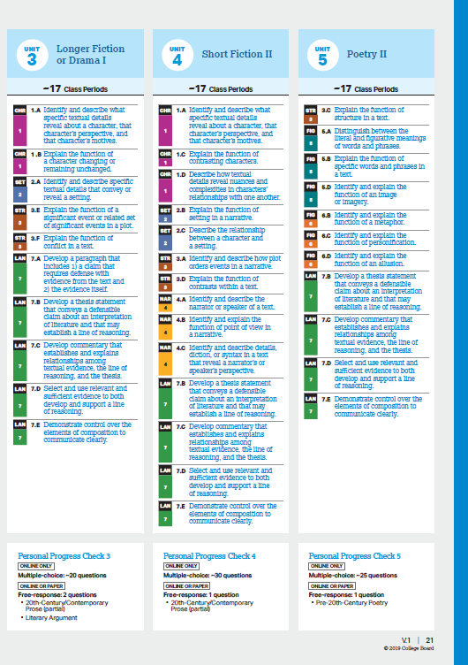
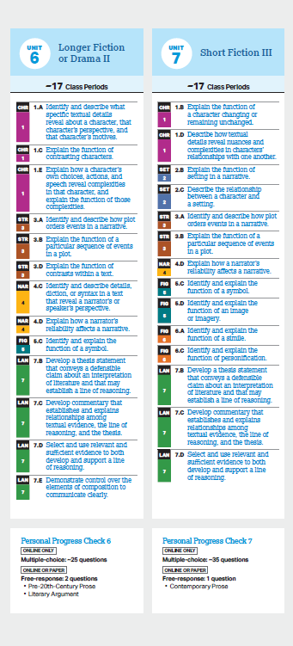
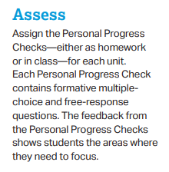
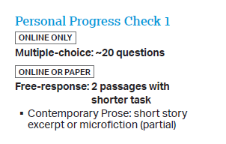
Personal Progress Checks Overview
Personal Progress Check information is provided at the bottom of the Course at a Glance.
Specifications include:
Approximate number of multiple-choice questions (MCQ)
Number of free-response questions (FRQ)
Types of free-response questions, including whether the FRQ represents a partial version of what students will encounter on the AP Exam
CED
pp. 20-23

Slide 14
Progress Dashboard Preview
View progress for every student and class across AP units and skills.
Notes:
The Course Summary highlights student progress across the units.
Teachers view their classes and students, and school and district administrators can view results for the schools, classes, and students they’re responsible for.
Related note: any administrator with access to AP Classroom will be able to view this data, which is why access is granted using the same access code for AP Scores.
Be sure to only include administrators who should have access to student data.

Slide 15
Equity and access Planning for remediation and enrichment after assessment Questions to consider
What is mastery according to PPC results?
Individual?
class? What will you do if your class does not show mastery on most of the unit’s skills? Will you delay starting the next unit? Do you have to cover all nine units? How do you remediate students who do not show mastery on most of the unit’s skills? What will you do when a class or individual does not show mastery of a particular skill? What will you do if a class or individual masters course skill(s) quickly
This Photo by Unknown Author is licensed under CC BY-ND

