Slide 1
Culturally Responsive Teaching
in the AP® Classroom
Adapted from a presentation by Dr. Brandon Abdon
AP English Literature and
AP English Language Consultant
This Photo by Unknown Author is licensed under CC BY-SA-NC

Slide 2
AP® Access and Equity Statement
The College Board and the Advanced Placement Program® encourage teachers, AP Coordinators, and school administrators to make equitable access a guiding principle for their AP programs.
The College Board is committed to the principle that all students deserve an opportunity to participate in rigorous and academically challenging courses and programs.
All students who are willing to accept the challenge of a rigorous academic curriculum should be considered for admission to AP courses.
The Board encourages the elimination of barriers that restrict access to AP courses for students from ethnic, racial, and socioeconomic groups that have been traditionally underrepresented in the AP Program.
Schools should make every effort to ensure that their AP classes reflect the diversity of their student population.

Slide 3
Things that worry me:
Strides have been made to provide more access to AP but there is still a significant way to go regarding equity.
Access is provided, but there has been little or no revision of content and pedagogy to accommodate different backgrounds and experiences.
“Equity and Access” - the essential term d’art for this work - is becoming a buzz phrase.
“Equity and access” are too easily becoming associated with other movements in education and unintentionally watering down.

Slide 4
“The number of Black students earning a passing score on an AP exam grew by 90 percent from 2009 to 2019, a rate of growth higher than for high school students as a whole.”
“This African American growth rate was from a very low base, however:
in 2019, just over 4 percent of exam-passing AP students were Black.”
“At that rate of growth, the U.S. would be celebrating its quadricentennial before African Americans received the number of passing scores equivalent to their share of the population.”
-Mark Carl Rom, Georgetown University and unpaid member of College Board’s AP Higher Education Advisory Council
This Photo by Unknown Author is licensed under CC BY-NC-ND

Slide 5
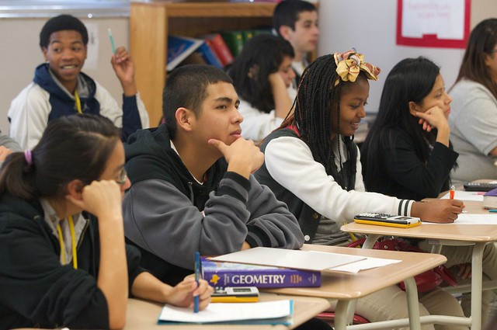
Black and Latino students often remain locked out of Advanced Placement (AP). “Black students make up 15% of high schoolers nationwide, but only 9% of students enrolled in at least one AP course. Nearly a quarter of students are Latino, but only 21% of students enrolled in AP courses are Latino.*”
-The Education Trust
This Photo by Unknown Author is licensed under CC BY

Slide 6
“District-level resources and state policies that provide greater access to AP are also associated with wider racial enrollment gaps, implying that greater resources may engender racial disparity without adequate efforts to provide equitable access and support for minority students.”
-“College Acceleration for All?” from The American Enterprise Institute and funded by the Gates Foundation
This Photo by Unknown Author is licensed under CC BY-NC

Slide 7
Progress Made:
Work To Be Done

Slide 8
But this discussion is not about providing equitable access…
...instead, this is about creating an environment where everyone can see themselves as possibly successful.
This Photo by Unknown Author is licensed under CC BY

Slide 9
It has never been enough just to let students in. The course and the content must appeal to them and give them room to connect to the material.
This Photo by Unknown Author is licensed under CC BY-NC-ND

Slide 10
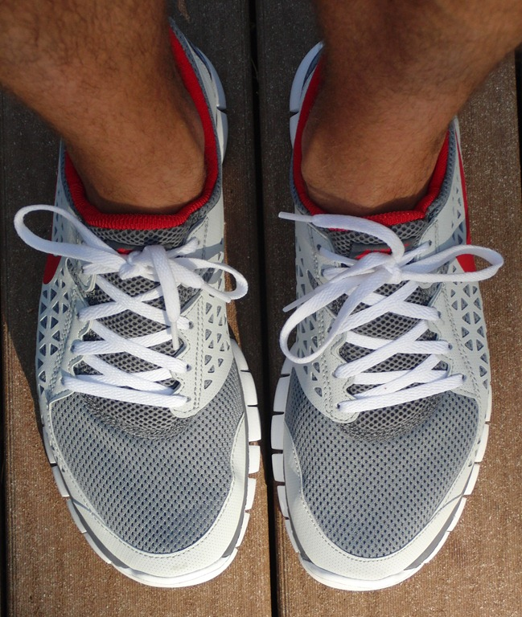
“Equality is ‘everybody gets a pair of shoes’; equity means everybody gets shoes that fit.”
This Photo by Unknown Author is licensed under CC BY-SA-NC
“Equality is ‘everybody has access to the course’; equity means the course can fit everyone”

Slide 11
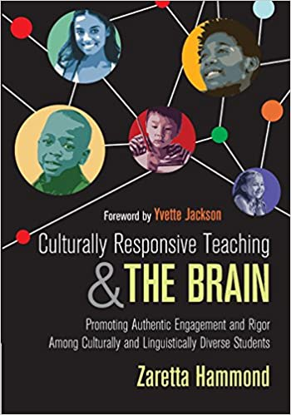

Slide 12
Culturally Responsive Teaching (CRT)
includes many of the hallmarks of effective teaching and management.
The problem emerges when we (I mean “me,” too) get comfortable with certain approaches and techniques that were right for one group of students but maybe not for others.

Slide 13
Being culturally responsive requires educators to constantly and consistently interrogate their practice

Slide 14
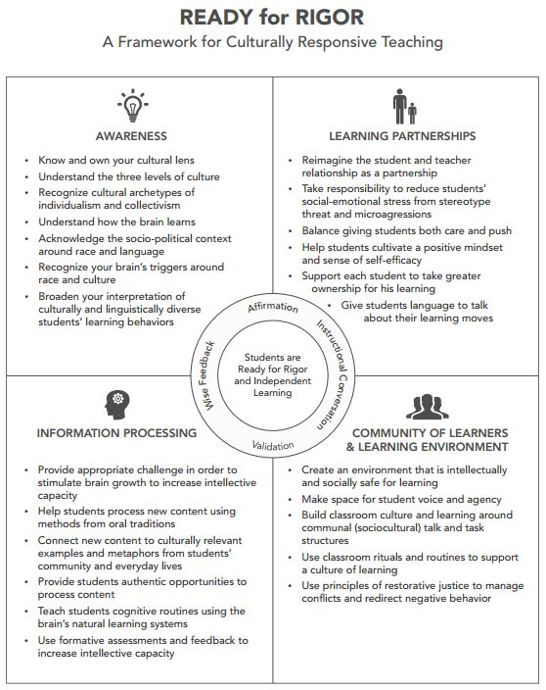
AWARENESS:
Who are you?
Where do you come from?
What experiences make you and create your perspectives on others?
PARTNERSHIPS:
Who are your students?
What can you learn from them?
How are they stereotyped?
INFO PROCESSING:
How do you challenge student skills (not just content)?
How does material relate to students’ lives/contexts?
How can you scaffold/ differentiate?
How do you know they are learning (or not)?
COMMUNITY:
Do students have a voice?
How are all students involved?
What routines and rituals support learning (not just management)?
How can students hold one another accountable?

Slide 15
This is NOT about any syllabus requirement or checkbox expectation; it is about reflective, professional practice.
As you consider this framework, how would you create / revise your course calendar, curricular materials, syllabus, etc.?
In your groups and throughout the APSI, share what parts of it influenced you the most as you consider your important work for the next year.

Slide 16
Inescapable Questions:
Do you love them enough to let them struggle?
Do they understand expectations and hold others accountable?
Do you give them feedback and data tied to their understanding of expectations?
Do you help them make connections between their own lives and learning?
Do they see how their learning can affect both their cultural and their broader-contextual communities?

Slide 17
Myth 1: Culturally responsive teaching is about motivating students of color.
Myth 2: Being culturally responsive requires a teacher to master the details of every culture represented in his classroom.
Myth 3: Culturally responsive pedagogy is about having a “bag of tricks” to use with particular racial groups.
Myth 4: Culturally responsive teaching is about respecting the “culture of poverty.”
Myth 5: Only teachers of color have the skills to be truly culturally responsive.
5 Common Myths about Culturally Responsive Pedagogy

Slide 18
Critical Race Theory
Bootstrapping
Social Justice
Guilt or Shame
Fully Democratic Classroom
Just Talking About Race
Focused on Race
Focused on Poverty
Censoring Books / Texts
Choosing Books / Texts
Giving Students an Excuse
CRT is not...

Slide 19
about recognizing the unique experiences and perspectives of all people (including those of the teacher); how those perspectives affect learning, interactions with one another, and the dynamics of communities; and creating responsible, independent, and motivated learners.
CRT is...

Slide 20
What Now? Suggestions…..
As consultant I have, for this summer, attempted to revise this APSI through the lens of CRT. (Not as successful I hoped, but I tried)
May I encourage you to reflect on your own practice and how you are or could be more responsive to cultures.
How might you interrogate curricular materials and syllabuses for the fundamentals of CRT?
When you return to your school could you collaborate with collegues on a set of instructional and classroom routines and rituals that follow the principles of CRT?
Can we generally support each other as we consider how we are meeting the needs of underrepresented students in our classroom?

Slide 21
We will watch this brief video
Author Ernest Morrell On Culturally Responsive Learning

Slide 22
Sources:
Black and Latino Students Shut Out of Advanced Coursework Opportunities (The Education Trust, January 2020)
College acceleration for all? Mapping racial gaps in Advanced Placement and dual enrollment participation. (American Enterprise Institute, December 2020)
Diversifying AP (Inside HigherEd, October 2020)

